Slide 1
M. Tech (CSE) – Second Semester (Term: June-Aug 2022) Non CIE Component
Department of Computer Science and Engineering
Quantum Computing (MCS22)
TELEPORTATION
Presented By:
Aishwarya M F Prabhakar
1MS21SCS01

Slide 2
INTRODUCTION
Brief History
Idea was by Charles Bennett and co-workers from IBM in 1993
In 2017, Chinese scientists were able to teleport a photon to a satellite in the lower earth orbit
An outcome of this is that the information of one photon can be transferred to the other, a process called teleportation.

Slide 3
INTRODUCTION
QUANTUM TELEPORTATION VS MATERIAL TELEPORTATION
Teleportation
Dematerializing a body from one place and Materializing it at another place.
Quantum Teleportation
Transferring quantum information from one qubit to another without any medium

Slide 4
DEFINITION
Quantum teleportation is a technique for moving quantum states around, even in the absence of a quantum communications channel linking the sender of the quantum state to the recipient.

Slide 5
DEFINITION
Quantum Teleportation or Entanglement-assisted teleportation, is a process by which a qubit (the basic unit of quantum information) can be transmitted exactly from one location to another, without the qubit being transmitted through the intervening space.
It includes making an object disintegrate in one place while a perfect replica appears somewhere else.

Slide 7
APPLICATIONS - NEED FOR TELEPORTATION
Quantum Teleportation can make future Networking and communication hacking proof.
Quick and Easy transfer of physical objects or oneself through long distances.
Quantum Computers are much faster than today’s computers.

Slide 8
FAILURE OF TELEPORTATION
Reasons why the physical body cannot be teleported and only the information is teleported:
Violated the Heisenberg’s Uncertainty Principle according to which one cannot perform a perfect scan of the object to be teleported.
No cloning theorem proves that Quantum information can neither be copied or destroyed. Because this implicitly does a measurement which destroys the quantum states.

Slide 9
SUCCESS OF TELEPORTATION
Teleportation has only been successful with photons.
And this happens only if the Sender and Receiver are Entangled.
The failures related to cloning can also be conquered using Entanglement and by building a Quantum teleportation circuit.

Slide 10
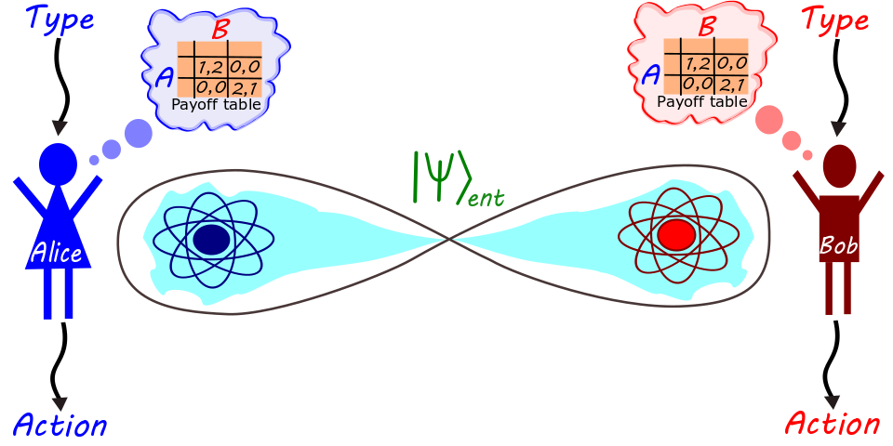
ENTANGLEMENT
When two particles have opposite spin and have a single wave function.
Spin is an angular momentum and inclination in space.

Slide 11
ENTANGLEMENT
When both Particles are observed together they have both up-state and down-state simultaneously (SUPERPOSITION)
When the Particles are observed individually – their state and wave function collapses.
Therefore, we will not be able to teleport the Photon X in space when observed individually.
So they must be measured in combined state –
BELL MEASUREMENT

Slide 12
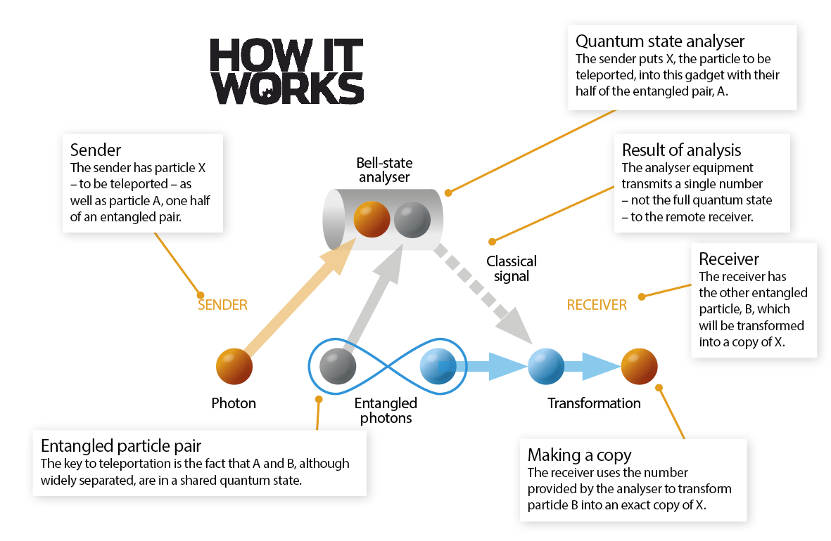

Slide 13
THE PROCESS OF TELEPORTATION
ASSUME
Alice is the Source, will have Photon A
Bob is the Destination, will have Photon B
Alice want to send PHOTON C to Bob
Source(Alice) -----Photon C ------🡪 Destination(Bob)
Photon A and Photon B are entangled.

Slide 14
THE PROCESS OF TELEPORTATION
Measure A and C in combined state
A interacts with C
A is already entangled with B
So, Quantum info of C is transferred to B via A
Photon C -------------Photon A------------🡪 Photon B
Notes:
Since Alice has Both A and C photon , they are observed together

Slide 15
THE PROCESS OF TELEPORTATION
So now B has the info of C
And by Manipulation of C we can make a perfect clone of Photon C
Due to Manipulation of C, it changes and has different state and properties. Because all the properties were transferred from C to B
After this entanglement of A and B breaks.

Slide 16
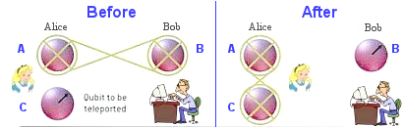
Therefore TELEPORTATION was successful
from Source(Alice) to Destination(Bob)

Slide 17
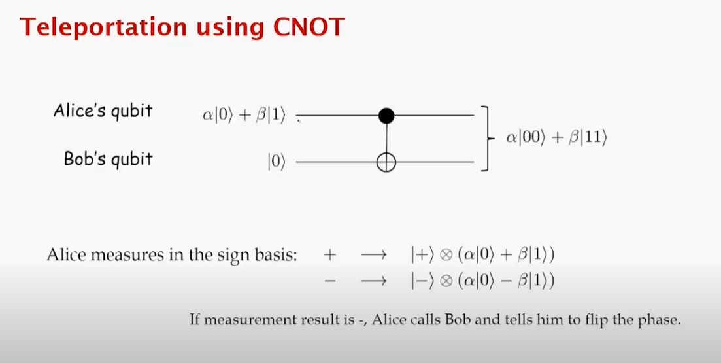
TELEPORTATION PROTOCOL (IN TERMS OF GATES & BITS)
Textbook: Quantum Computing for everyone – Chris Bernhardt

Slide 18
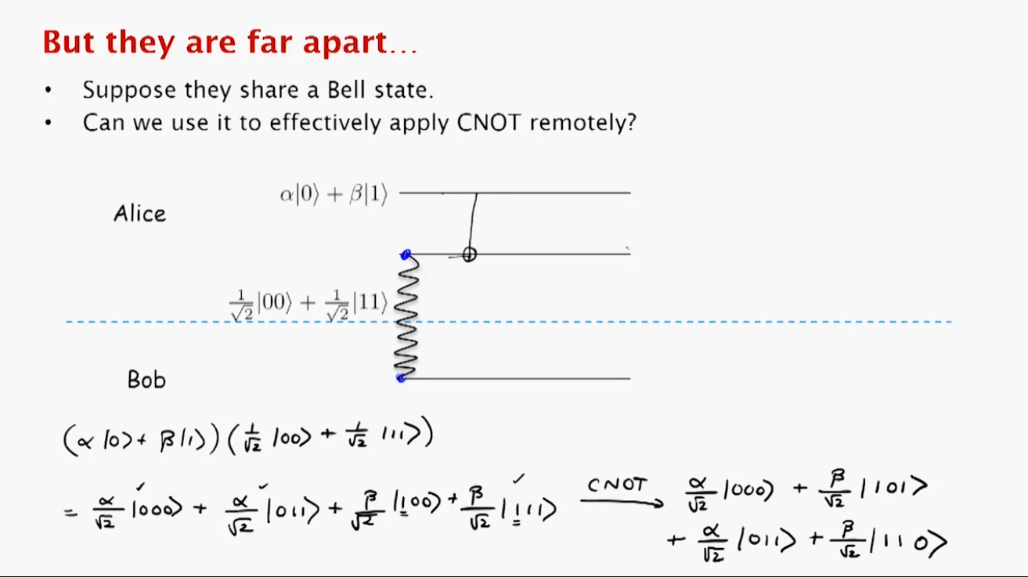
TELEPORTATION PROTOCOL (IN TERMS OF GATES & BITS)

Slide 19
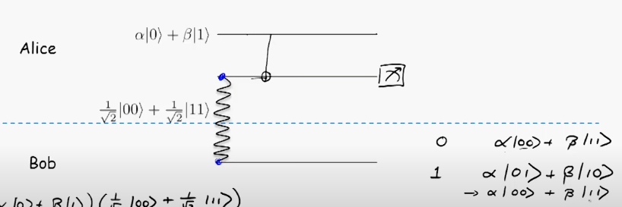
TELEPORTATION PROTOCOL (IN TERMS OF GATES & BITS)

Slide 20
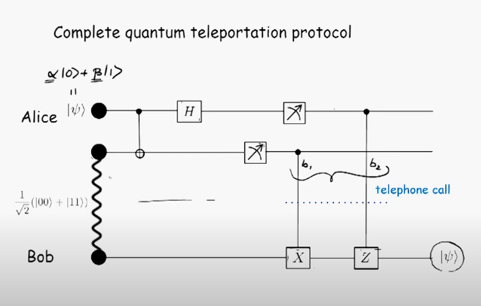
TELEPORTATION PROTOCOL

Slide 21
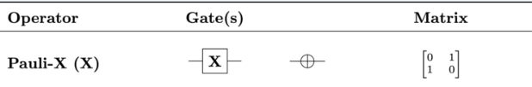
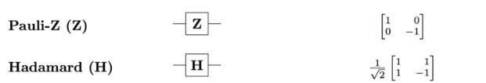
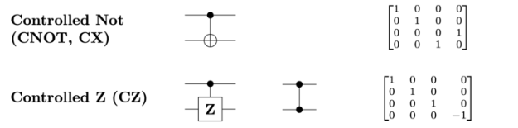
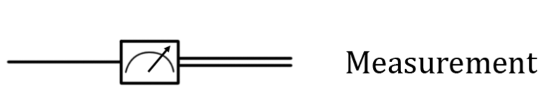

Slide 22
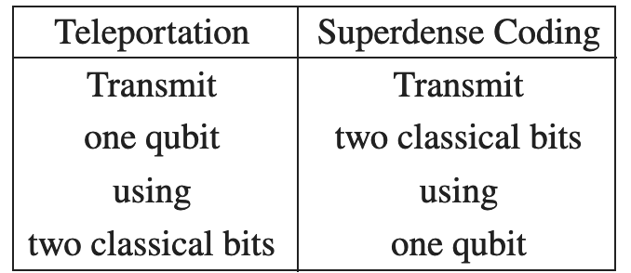
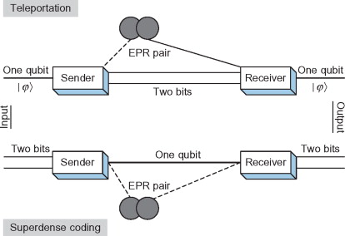
TELEPORTATION VS SUPERDENSE CODING

Slide 23
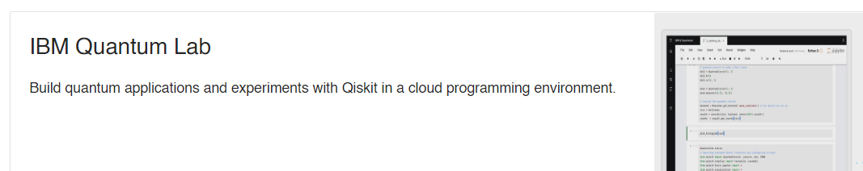


IMPLEMENTATION
Steps to open Qiskit:
Open https://qiskit.org/
Click on GET STARTED
Navigate and Select to Start on Cloud
Choose
Log in or Sign up
Choose
File > New > Notebook > Python 3 (ipykernel)
Type your code here
From Quiskit Textbook:
https://qiskit.org/textbook/ch-algorithms/teleportation.html

Slide 24
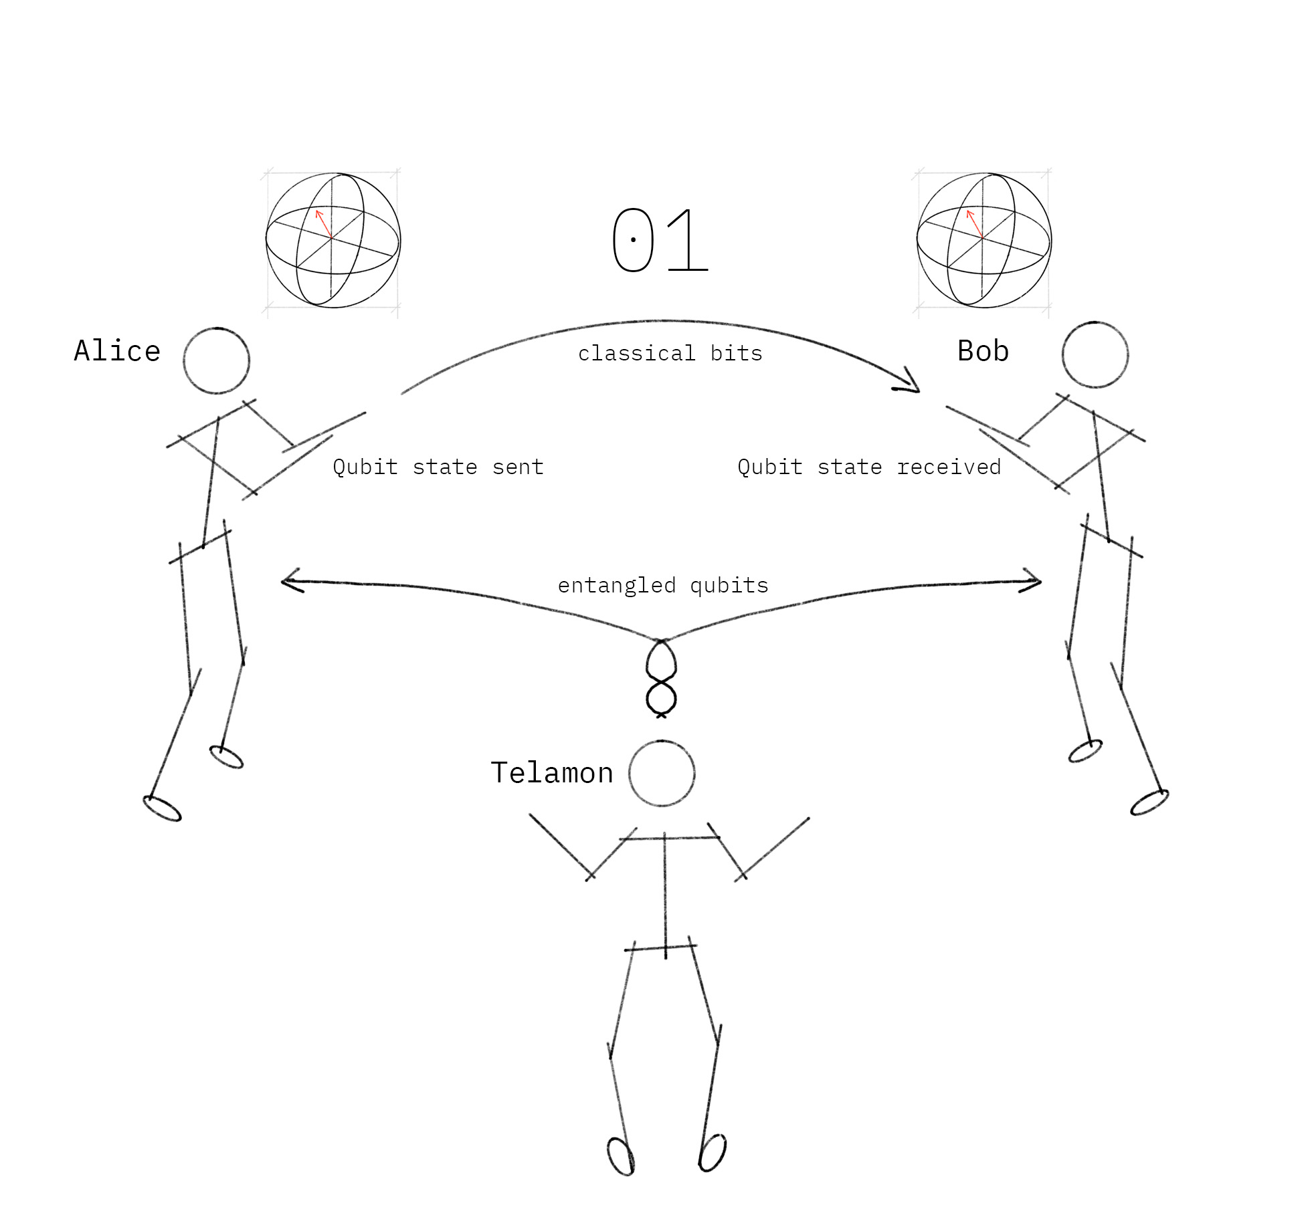

Slide 25
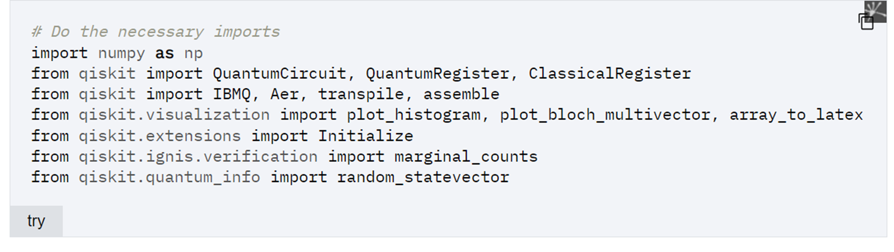
Importing necessary libraries:

Slide 26
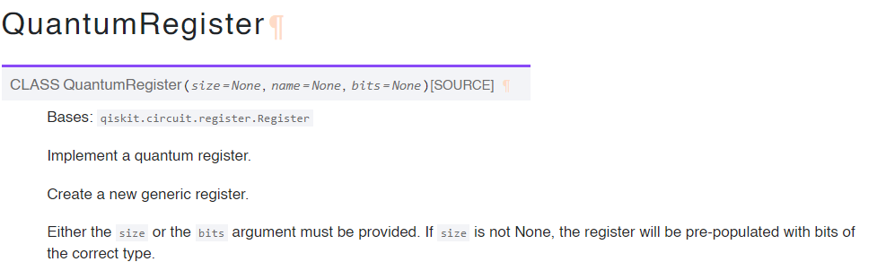
LIBRARIES USED IN CODE
NumPy is a Python library used for working with arrays. It also has functions for working in domain of linear algebra, fourier transform, and matrices.
.

Slide 27
LIBRARIES USED IN CODE
Aer - is a high performance simulator for quantum circuits that includes noise models
Statevector - This can be either a complex vector, another statevector, a Operator with only one column or a QuantumCircuit or Instruction.
QasmSimulator - supports multiple simulation methods and configurable options for each simulation method.

Slide 28
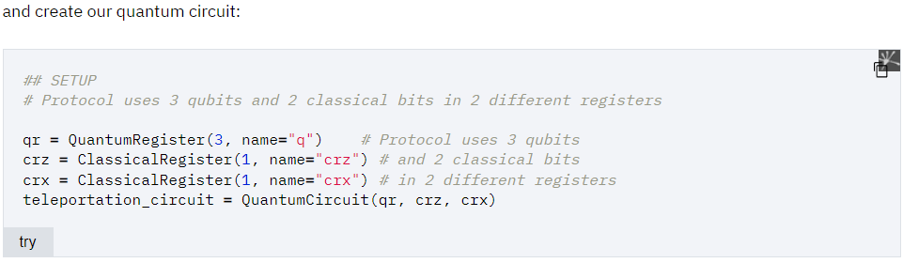

Slide 29
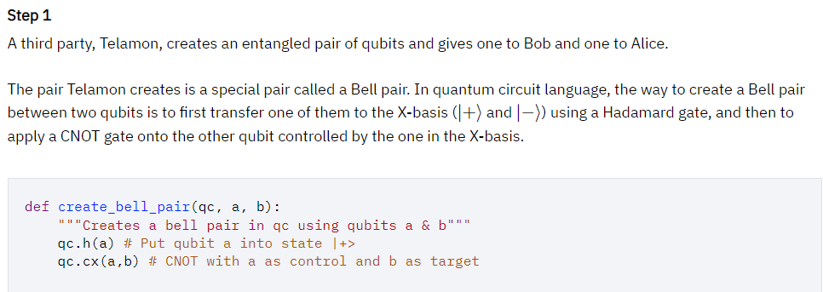

Slide 30
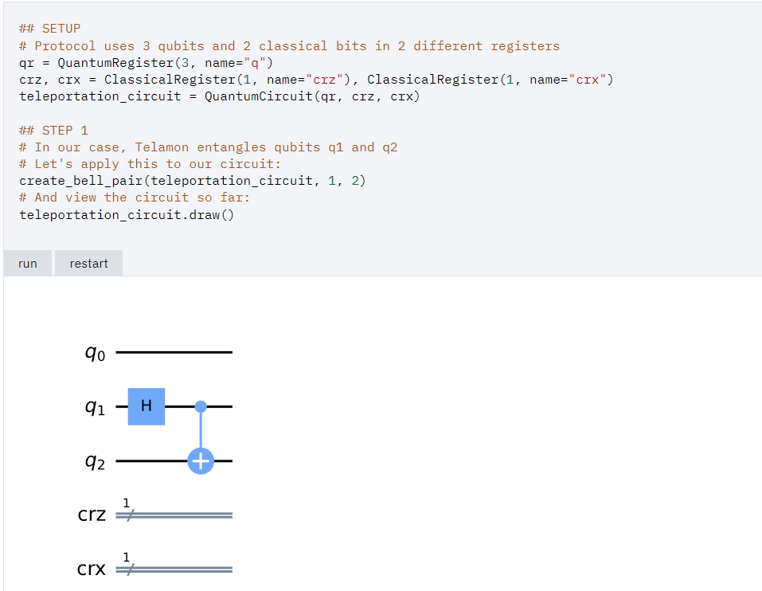

Slide 31
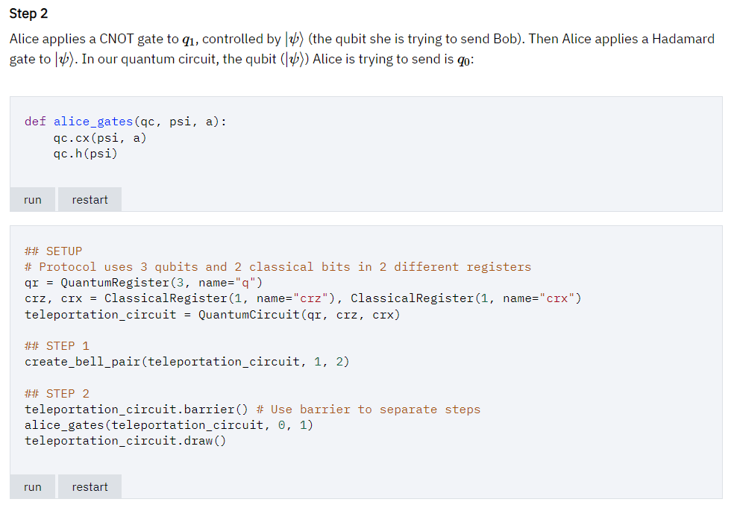

Slide 32
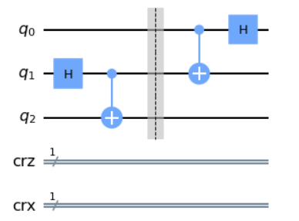

Slide 33
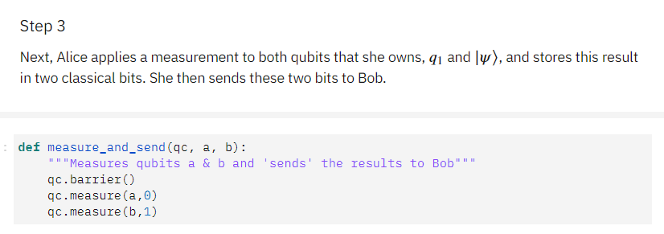

Slide 34
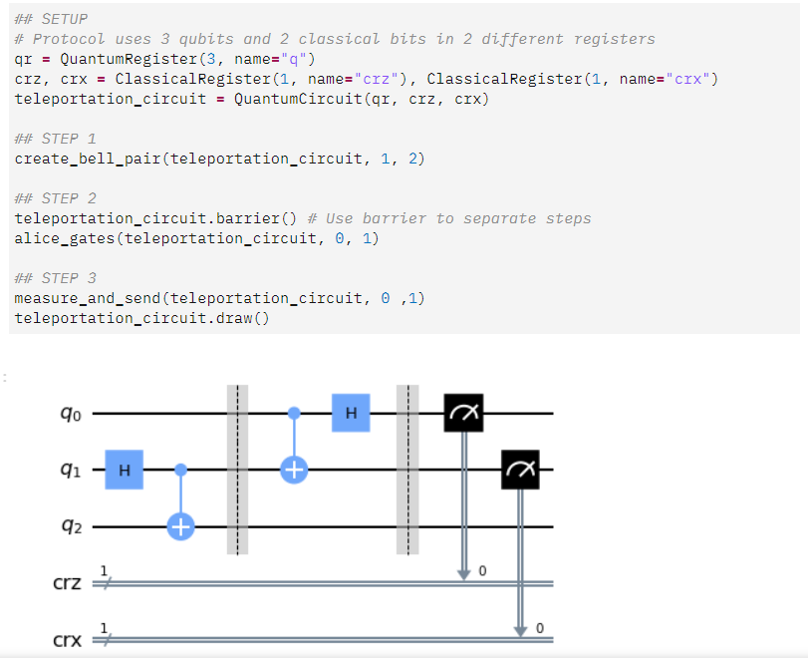

Slide 35
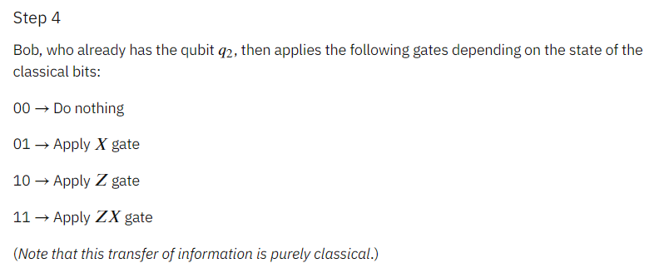

Slide 36
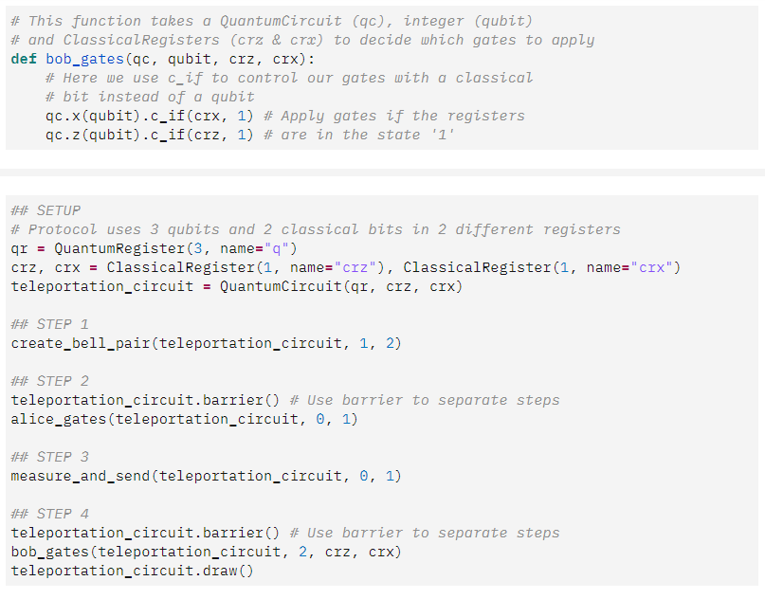

Slide 37
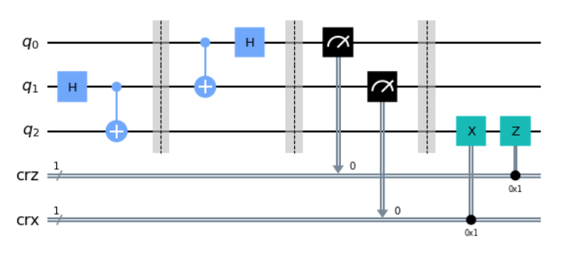

Slide 38
QUESTION:
Suppose we need to transfer a Photon X from one point to another, what method is used? Using a suitable diagram, explain the process.

Slide 39
REFERENCES
Nielsen, Michael A., and Isaac Chuang. "Quantum computation and quantum information." (2002): 558-559.
Lipton, Richard J., and Kenneth W. Regan. Quantum Algorithms via Linear Algebra: A Primer. MIT Press, 2014.
Bernhardt, Chris. Quantum computing for everyone. Mit Press, 2019.
https://qiskit.org/textbook/ch-algorithms/teleportation.html
Quantum Teleportation – Biswajit Pratihari
YouTube –Insane Curiosity - What Is Quantum Teleportation?
YouTube – Wobbly Bit L6.4 Teleportation (Quantum Mechanics and Computation)
YouTube – Tattvamasi - Quantum Teleportation Implementation Qiskit tutorial | Quantum Computing tutorial | Quantum Physics

Slide 40
THANK YOU

